Slide 1







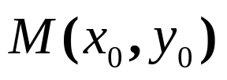
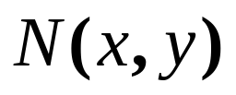




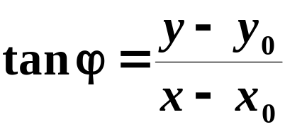
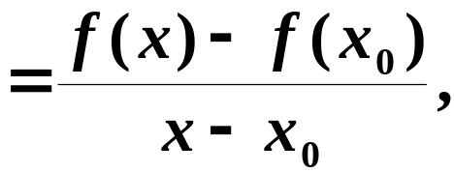
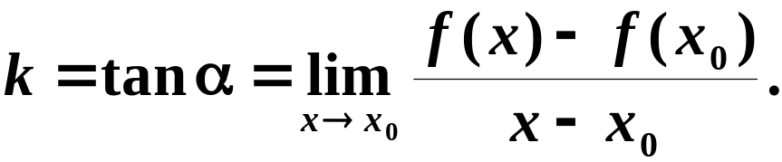
Section 3.1, 3.2 The Derivatives
Example 1. The slope of the curve
The tangent line of the curve
at the point M:
As N approaches M along the curve, the secant line MN tends towards the tangent line MT
Let , , the slope
of the secant line MN is
The slope of the tangent line MT is

Slide 2
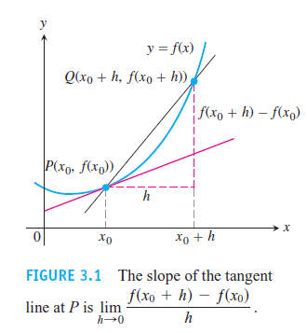
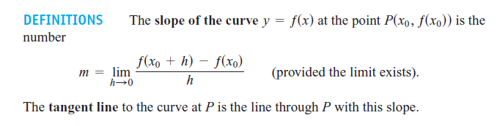

Slide 3

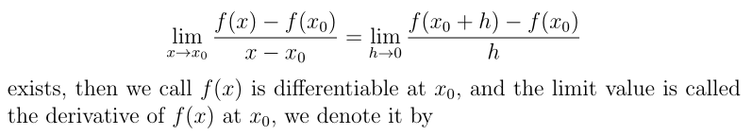
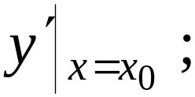
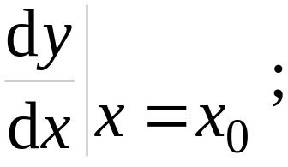
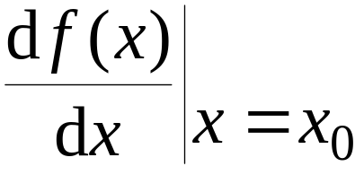

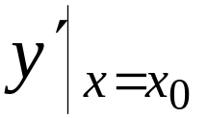
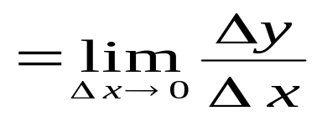

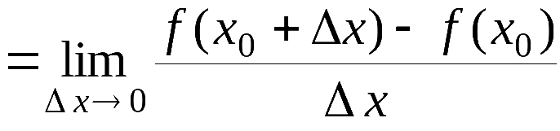
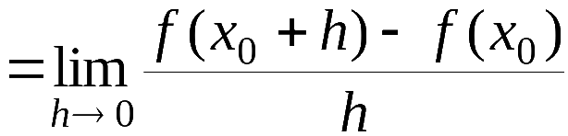
Definition 1: If the function is defined
on a neighborhood of , and the limit

Slide 4
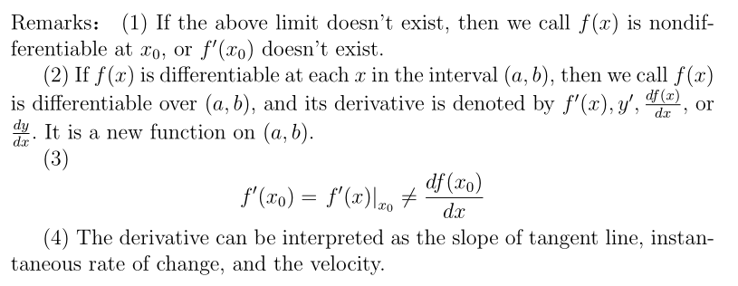
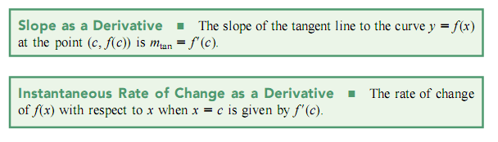

Slide 5
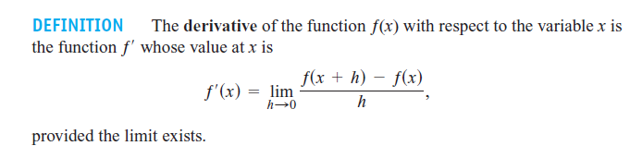


Example 2.
Example 3.

Slide 6
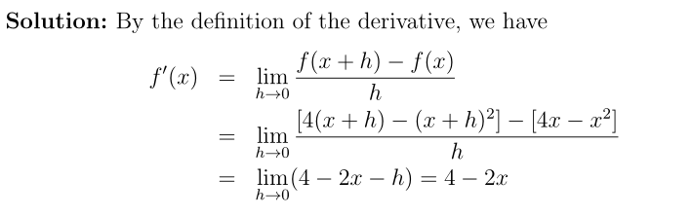
Example 4.

Slide 7
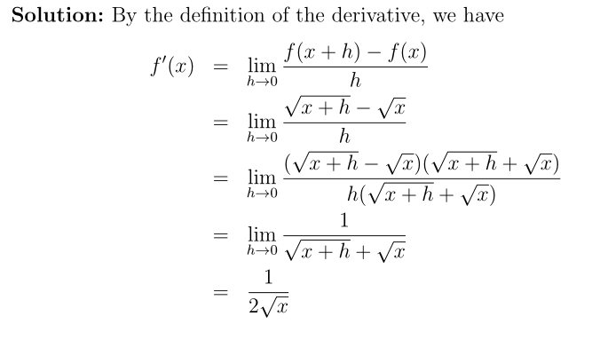

Example 5.

Slide 8
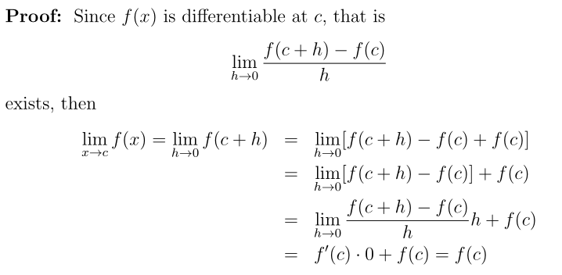
Theorem 1.

Slide 9


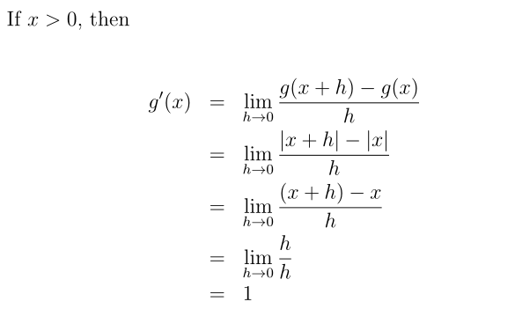
Example 6.

Slide 10
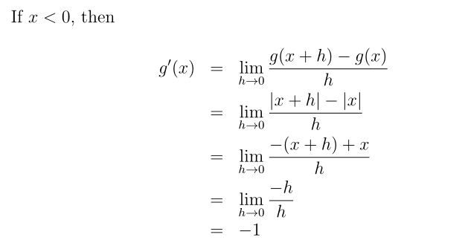
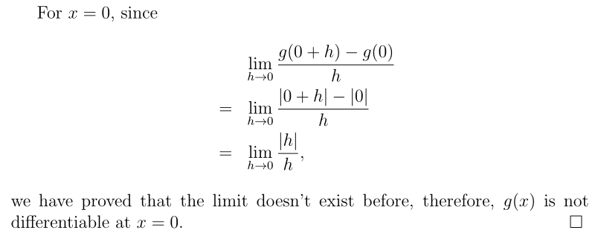

Slide 11
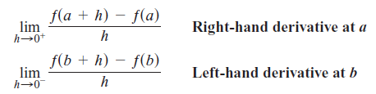
Differentiable on an Interval; One-Sided Derivatives
A function y = ƒ(x) is differentiable on an open interval (finite or infinite) if it has a derivative at each point of the interval. It is differentiable on a closed interval [a, b] if it is differentiable on the interior (a, b) and if the limits
exist at the endpoints

Slide 12
EXAMPLE 6 indicates that the function y=|x| is differentiable on (−∞, 0) and (0, +∞), but has no derivative at x=0.

Slide 13
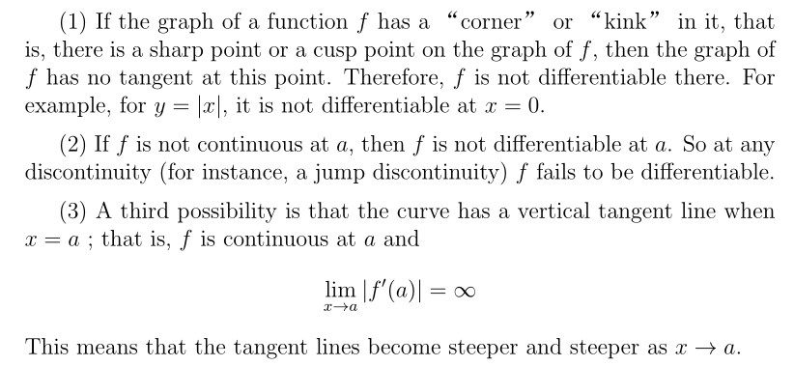

Slide 14
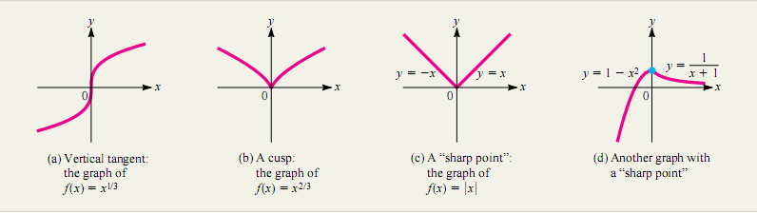

Slide 15

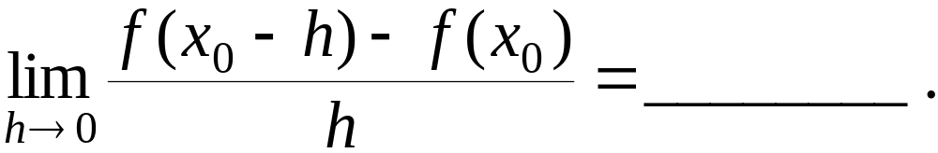
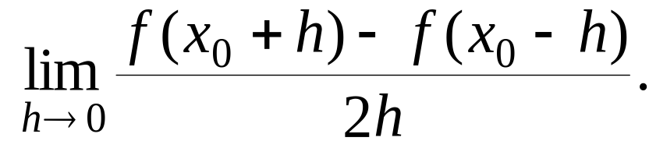
Example 7. If exists, then
Example 8. If exists, find

